Slide 1
2D Transformation (part-1)
Course Code: CSC 3224
Course Title: Computer Graphics
Dept. of Computer Science
Faculty of Science and Technology
Lecturer No: | 6 | Week No: | 05 | Semester:
Lecturer: | Md Masum Billah, billah.masumcu@aiub.edu, masum-billah.net

Slide 2
Lecture Outline
2D Transformation (Derivation)
Translation
Scaling
Rotation (Clockwise and Anti-Clockwise)
Homogeneous 2D Transformation
Mirror Reflection

Slide 3
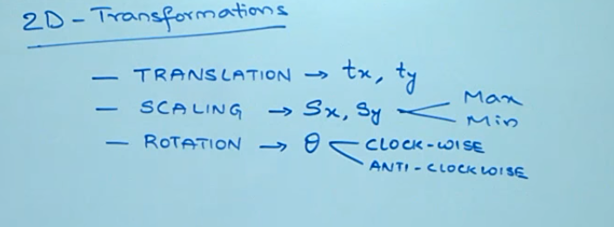
2D Transformation
Introduction

Slide 4
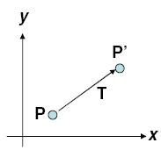
2D Transformation
Introduction
Move/translate/displace a point to a new location
In effect, moving original point position along a straight-line path to its new location
An object defined by multiple coordinate positions
Relocate all coordinate positions by same displacement along parallel paths
Every point on object is translated by same amount
Rigid-body, moves object without deformation

Slide 5





2D Transformation
Introduction
To translate original coordinates (x, y) by translational distances t_{x} and t_{y} to obtain new coordinate position (x’, y’)
Equation in matrix form
P = Original position
P’ = New position
T = Translational vector

Slide 6
2D Transformation
Introduction
To translate original coordinates (x, y) by translational distances t_{x} and t_{y} to obtain new coordinate position (x’, y’)
Equation in matrix form
P = Original position
P’ = New position
T = Translational vector

Slide 7

2D Scaling
Introduction
To alter the size of an object
Expand or contract along each axis
Simple 2D scaling operation performed by
Multiplying original object positions (x, y) by scaling factor s_{x} and s_{y} to produce scaled coordinates (x’, y’)
Equation in matrix form
P’ = P • S
P = Original position
P’ = New position
S = Scaling vector

Slide 8
2D Scaling
Introduction
Scaling factors
Less than 1 reduces size, greater than 1 increase size
Uniform scaling maintains relative object proportions
Equal scaling factors
As opposed to differential scaling (unequal scaling factors)
In some systems, negative values not only resize the object but reflects it about the perspective coordinate axes

Slide 9
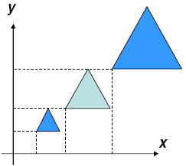
2D Scaling
Introduction
Object transformed using simple scaling both scaled and repositioned
Scaling factors with absolute values less than 1 move o objects closer to coordinate origin
V values greater than 1 move objects further

Slide 10

2D Rotation (Anti-clockwise)
Introduction
Rotation :
Equation in matrix form
P = Original position
P’ = R • P P’ = New position
R = Rotation vector
Where rotation matrix is

Slide 11
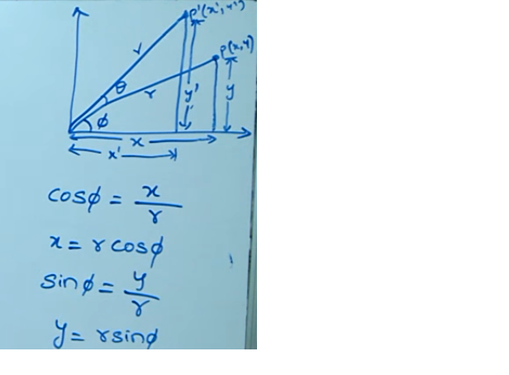
2D Rotation (Anti-clockwise)
Introduction

Slide 12
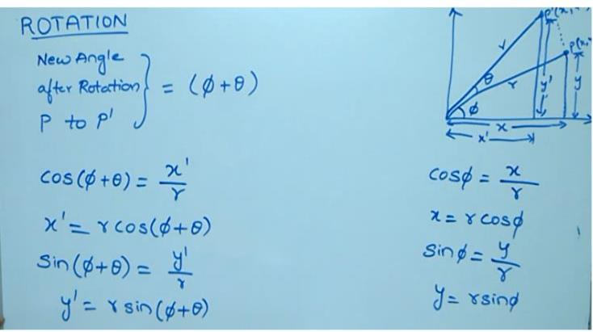
2D Rotation (Anti-clockwise)
Introduction

Slide 13
2D Rotation (Anti-clockwise)
Introduction
COS(A+B)= COSA.COSB-SINA.SINB
SIN(A+B)= SINA.COSB+COSA.SINB

Slide 14
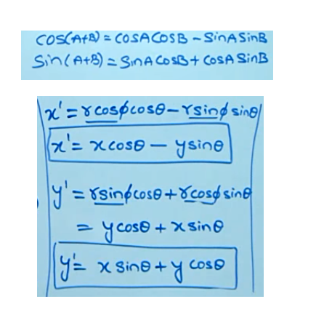
2D Rotation (Anti-clockwise)
Introduction

Slide 15
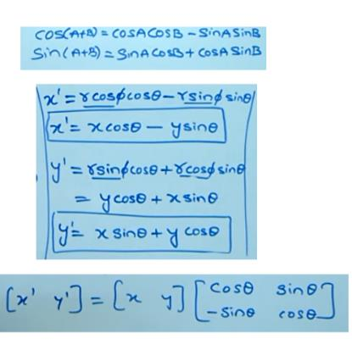
2D Rotation (Anti-clockwise)
Introduction

Slide 16
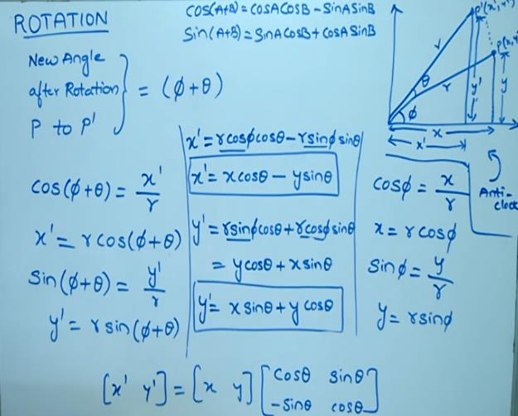
2D Rotation (Anti-clockwise)
Introduction

Slide 17
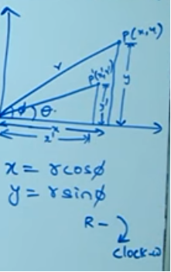
2D Rotation (clockwise)
Introduction

Slide 18
2D Rotation (clockwise)
Introduction
COS(A-B)= COSA.COSB+SINA.SINB
SIN(A-B)= SINA.COSB-COSA.SINB

Slide 19
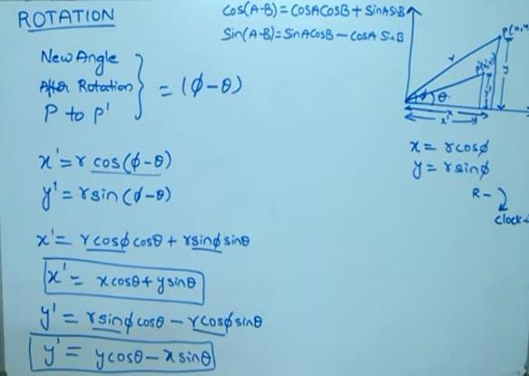
2D Rotation (clockwise)
Introduction

Slide 20
2D Rotation (clockwise)
Introduction

Slide 21
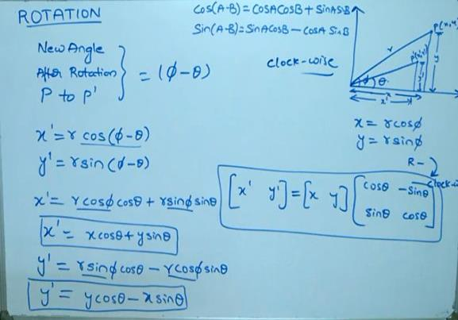
2D Rotation (clockwise)
Introduction

Slide 22
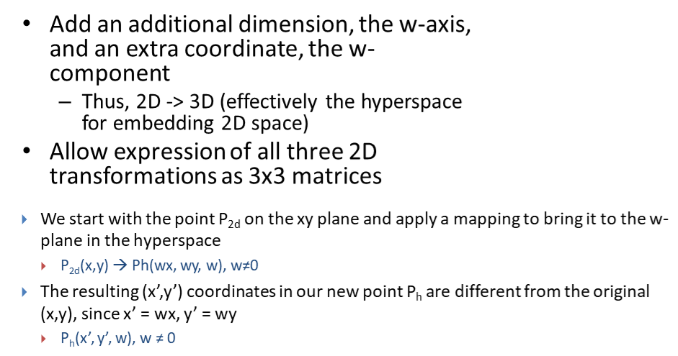
Homogeneous 2D Transformation

Slide 23
Homogeneous 2D Transformation
The transformations we use will always map points in the hyperplane defined by w = 1 to other such points.
In other words, we want our transformations T to map points v = to points v’ =

Slide 24
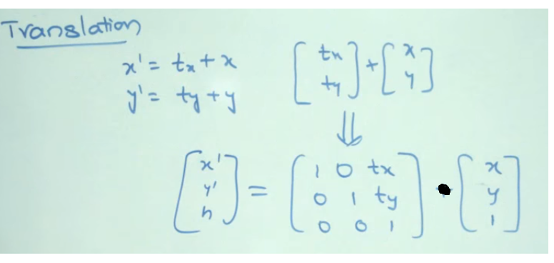
Homogeneous 2D Transformation
Homogenous Translation

Slide 25
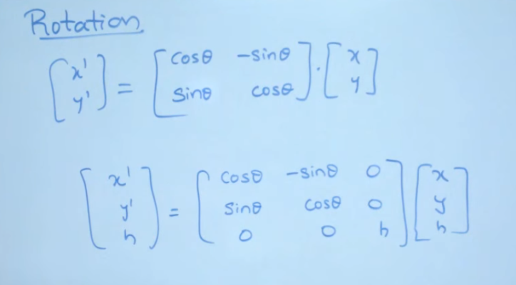
Homogeneous 2D Transformation
Homogenous Rotation

Slide 26
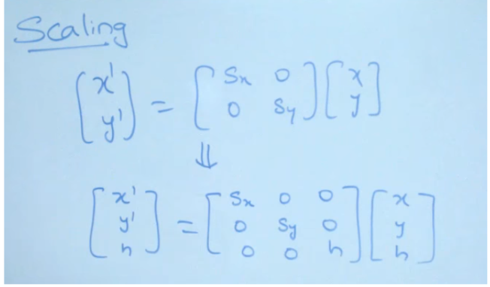
Homogeneous 2D Transformation
Homogenous Scaling

Slide 27
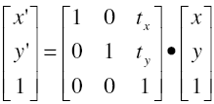

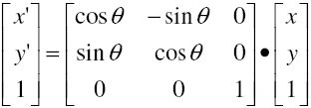
Homogeneous 2D Transformation
Homogenous Summary
2D translation matrix
P’ = T • P
2D scaling matrix
P’ = S • P
2D rotation matrix
P’ = R • P

Slide 28
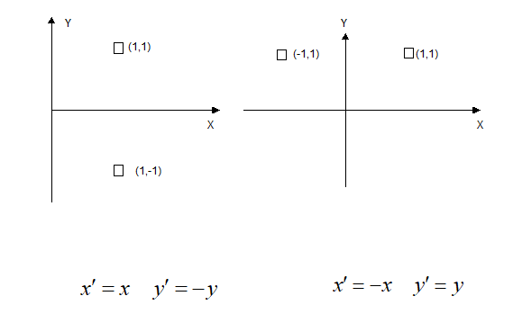
Mirror Reflection

Slide 29
Books
Foley, van Dam, Feiner, Hughes, Computer Graphics: principles and practice, Addison Wesley, Second Edition.
Schaum's Outline of Theory & Problems of Computer Graphics.
Peter Shirley Steve Marschner , “Fundamental of computer graphics”, Third Edition.

Slide 30
References
Chapter 5: Foley, van Dam, Feiner, Hughes, Computer Graphics: principles and practice,
Addison Wesley, Second Edition.
https://www.gatevidyalay.com/2d-transformation-in-computer-
graphics-translation-examples/
https://www.slideshare.net/poojadixit19/2dtransformation-130682981

